Slide 1
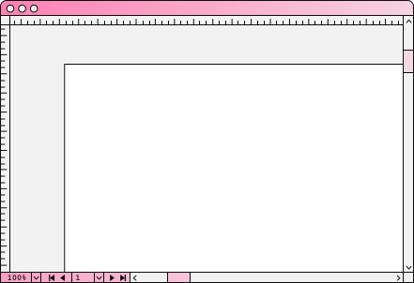

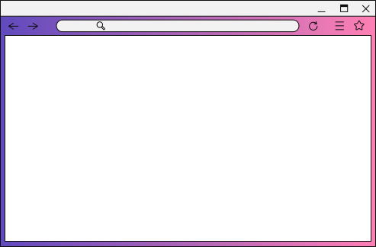

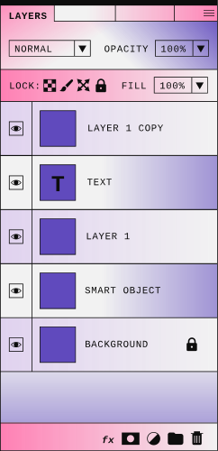

UNTITLED
UI/UX SEMINAR
AN ALAGAMMAI
2nd year CSE

Slide 2

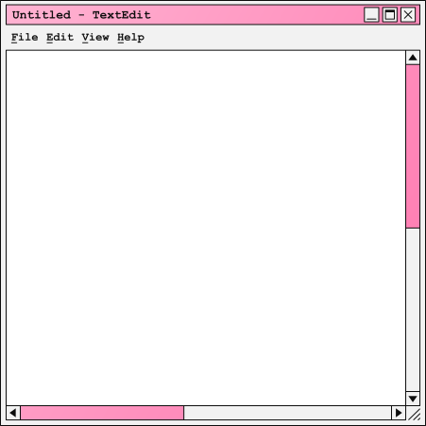

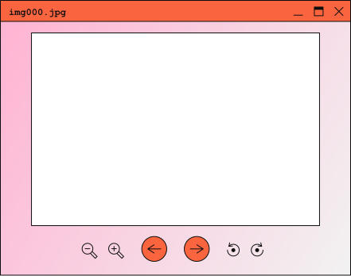

Overview
01 | problem
02 | UX vs UI
03 | Purposes of UX
04 | Purposes of UI
05 | Design Tools
06 | Summary
Tip: Use links to go to a different page inside your presentation.
How: Highlight text, click on the link symbol on the toolbar, and select the page in your presentation you want to connect.

Slide 3

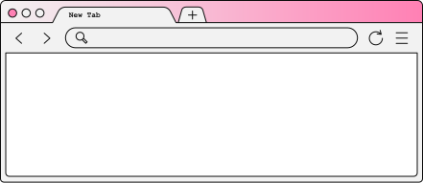

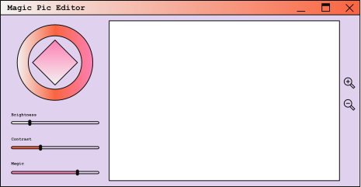
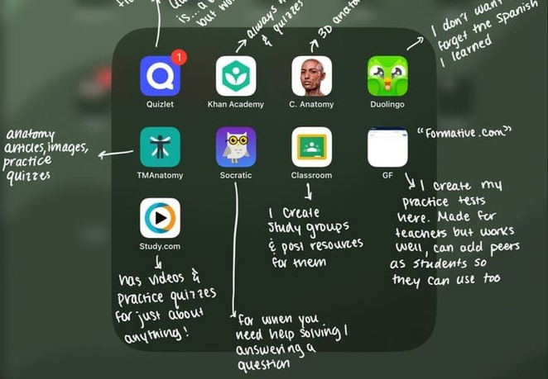
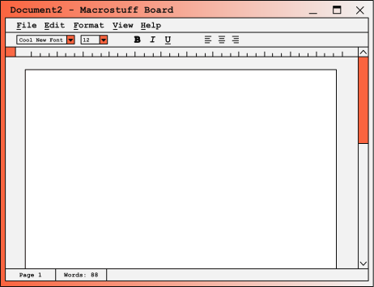
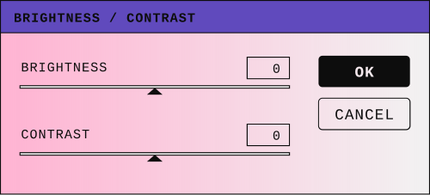
Hi, I'm the Problem!
why use UI/UX? is UI different from UX? if so how?
where can we do this? what is the use of UI/UX? we have lots of doubt so, lets learn them Here!!
Back to Agenda Page
Your paragraph text

Slide 4
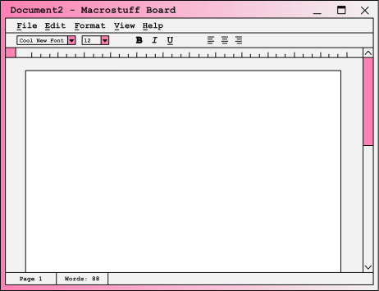

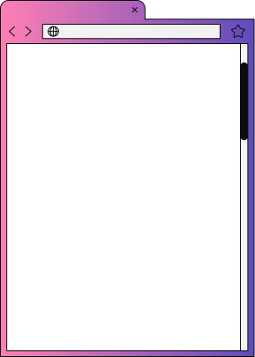
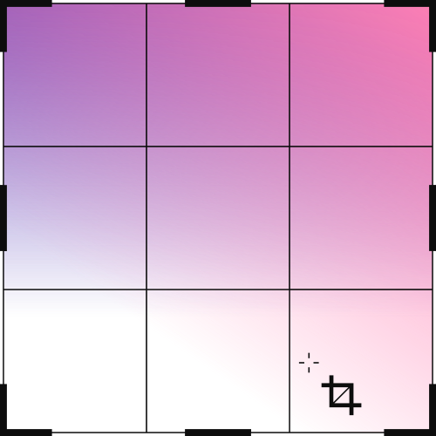
UX vs UI
USER INTERFACE DESIGN
USER EXPEIRENCE DESIGN
iits mostly dependent on the way it looks
products that end up for the delight of the users asthetics
its dependents on how it works
how somebody uses it
products that delight the user for their effectiveness
Back to Agenda Page

Slide 5
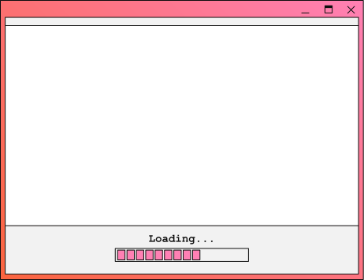


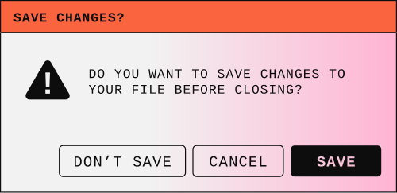
Purpose of UX
create products that provide meaningful and relavent experience to users. these arealso invovled in research,designing,testing and evaluating products and improving them.

Slide 6

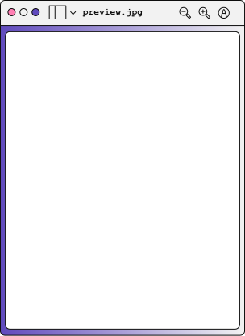
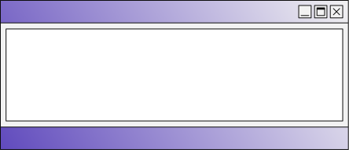
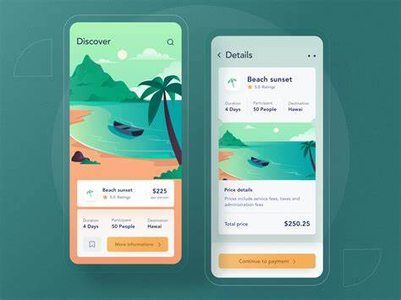
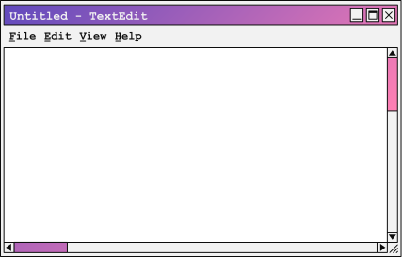
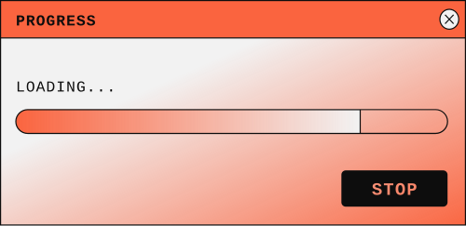
Purpose of UI
these are used to build interface in software . their main purpose is to make sure that the app or website looks Appeling at a glance to users.
Back to Agenda Page

Slide 7
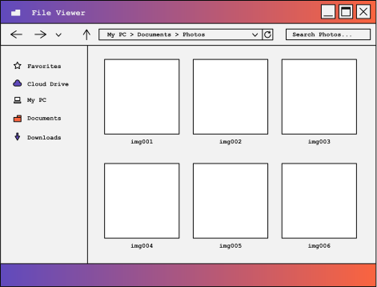
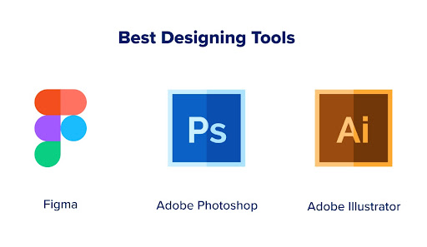

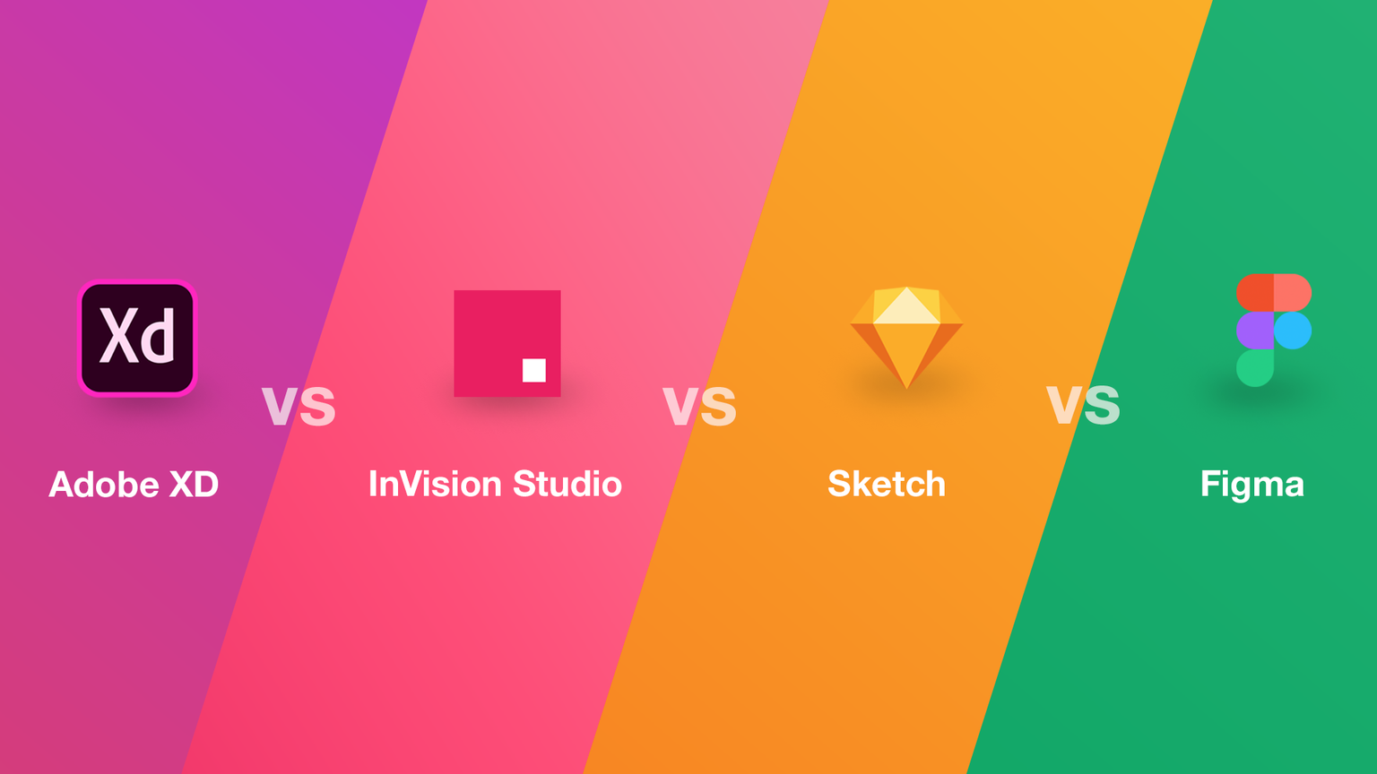


Design Tools
there are many design tool available in the market the famously known one is figma
Design Tool - they help in formating 3D,2D images . creates basic layout for products

Slide 8
THANK YOU
WEBSITE
EMAIL
PHONE

